Slide 1

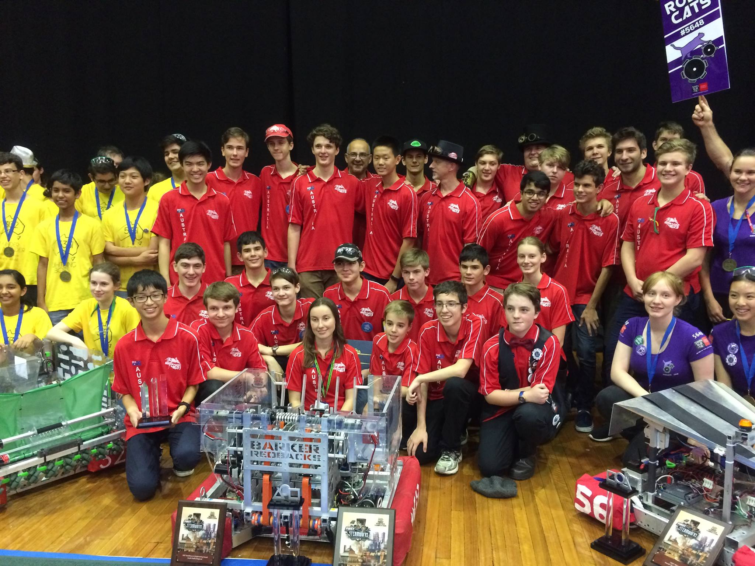
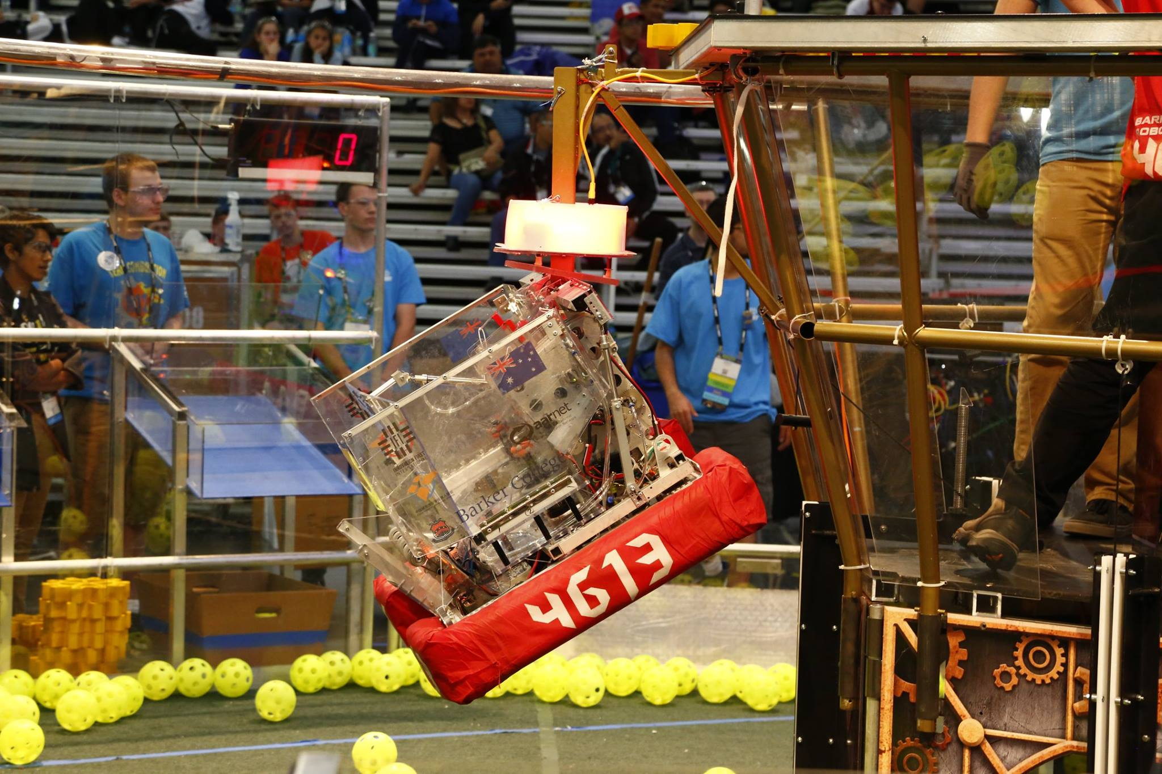
Introduction to (Java) Programming – 2.3 - Input
Tom Schwarz

Slide 2
Lesson 4: Input
Taking input lets your code become dynamic
Java comes with code to take input from the console in the ‘Scanner’ package
We can create a new ‘Scanner’ variable with the value of a new scanner instance
Scanner keyboardInput = new Scanner(System.in);
This creates a new variable, called keyboardInput, with the value of a new Scanner. We give scanner some information, which is what to scan. We tell it to scan (System.in)

Slide 3
Lesson 4: Input
Now to take some input.
Calling keyboardInput.nextLine() will return a String of what has been typed into the console
For example:
Scanner keyboardInput = new Scanner(System.in); System.out.print("What is your name? "); String name = keyboardInput.nextLine(); System.out.println("Hello " + name);
FYI if you take input without printing anything, it will look like your code is doing nothing. It’s just waiting for you to hit enter to continue executing.

Slide 4
Lesson 4: Input
Now do the activities!
https://github.com/Team4613-BarkerRedbacks/Programming-Java-Guide/blob/master/2.Core-elements-of-programs/2.3.Input.md

